Slide 1
THERMOCHEMISTRY OF VANADIUM CONTAINING SLAGS
Tatjana JANTZEN, Klaus HACK, Moritz TO BABEN
GTT-Technologies
Join our Users‘ Meeting on 26th to 28th of June
and follow our blog “Equilibrium of Things“:
https://gtt-technologies.de/blog/

Slide 2

Motivation
Thermochemical models allow calculation of equilibria, i.e.
  melting / solidification temperatures
  precipitate contents
  solubilities
  slag-metal equilibria
  slag-gas equilibria
Database FToxid in today used by ~1000 users in metallurgy and combustion.

Slide 3


Motivation
How do you navigate?
H
He
Li
Be
B
C
N
O
F
Ne
Na
Mg
Al
Si
P
S
Cl
Ar
K
Ca
Sc
Ti
V
Cr
Mn
Fe
Co
Ni
Cu
Zn
Ga
Ge
As
Se
Br
Kr
Rb
Sr
Y
Zr
Nb
Mo
Tc
Ru
Rh
Pd
Ag
Cd
In
Sc
Sb
Te
I
Xe
Cs
Ba
La
Hf
Ta
W
Re
Os
Ir
Pt
Au
Hg
Tl
Pb
Bi
Po
At
Rn
Fr
Ra
Ac
Rf
Db
Sg
Bh
Hs
Mt
Ds
La
Ce
Pr
Nd
Pm
Sm
Eu
Gd
Tb
Dy
Ho
Er
Tm
Yb
Lu
Ac
Th
Pa
U
Np
Pu
Am
Cm
Bk
Cf
Es
Fm
Md
No
Lr
Image from NASA (Hubble telescope)

Slide 4
Motivation
FToxid is dominant thermochemical database for slags/oxides.
GTOx is an independent database for slags/oxides and has been developed in a gasification project, together with FZ Jülich.
GTOx is used in biomass/coal combustion and gasification as well as metallurgy.
Recently, growing interest in vanadium oxide.

Slide 5
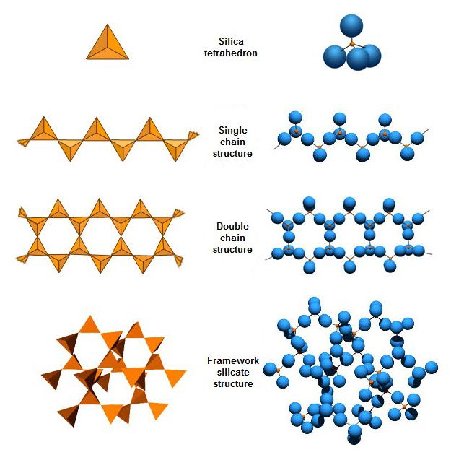
Thermochemistry of slags
“Solute“ SiO₂
“Solvent“ SiO₂
Models of slags have to include short-range order!

Slide 6
Thermochemistry of slags
Thermochemical models need to consider short-range ordering in the slag.
FToxid: quasichemical model:
Mg-O-Mg_{bond} + Si-O-Si_{bond} → 2 Mg-O-Si_{bond}
GTOx: associate species model
MgO + SiO₂ → MgSiO₃

Slide 7
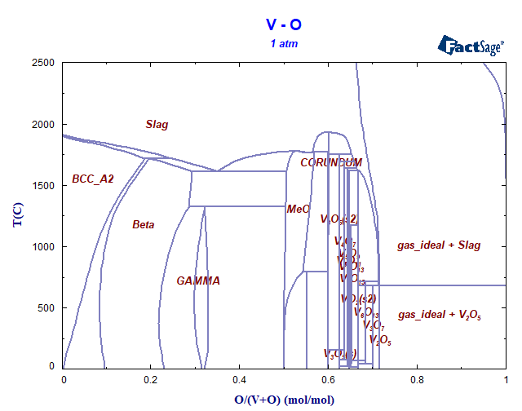
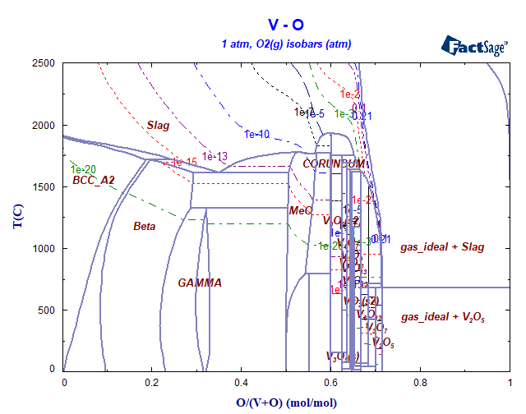
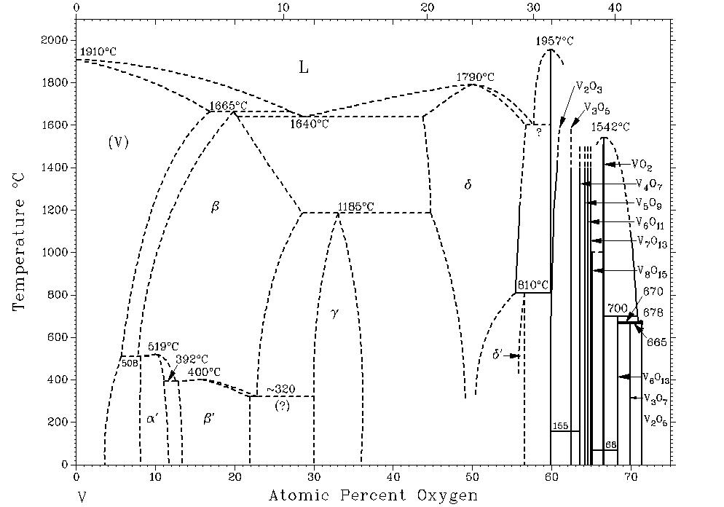
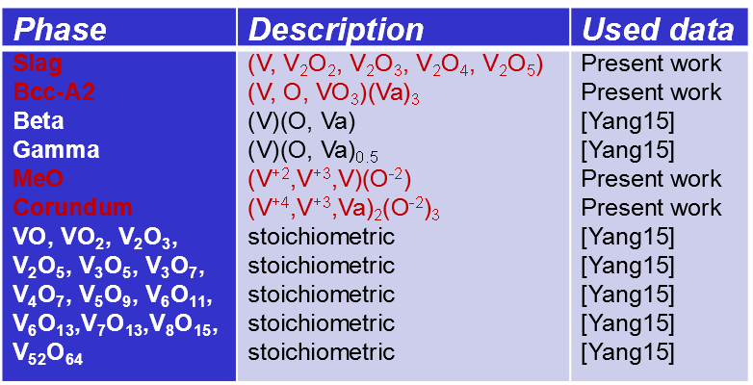
Thermochemistry of slags
T.B. Massalski (ed), Binary Alloy Phase Diagrams, Second Edition, ASM International, Metals Park, OH 1990.
Y. Yang, H. Mao, M. Selleby, CALPHAD, 51 144-160 (2015).

Slide 8
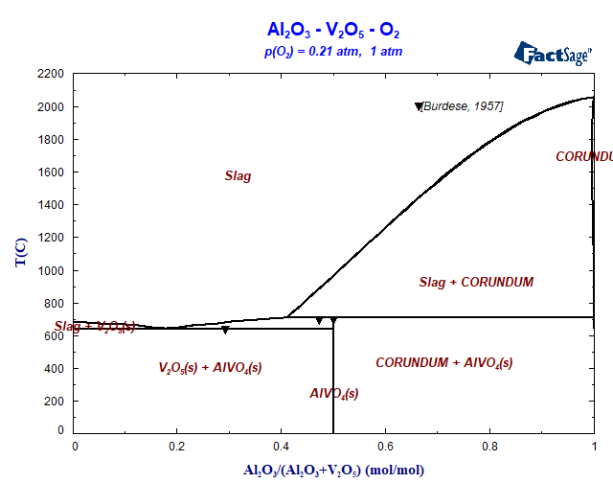
Al₂O₃ – V_{x}O_{y}
Oxidizing conditions

Slide 9
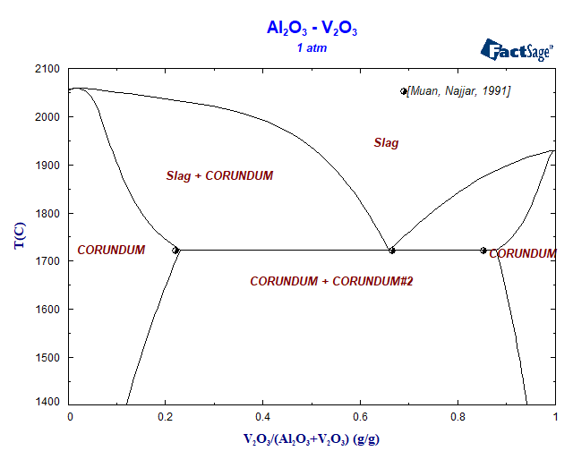
Al₂O₃ – V_{x}O_{y}
Reducing conditions

Slide 10
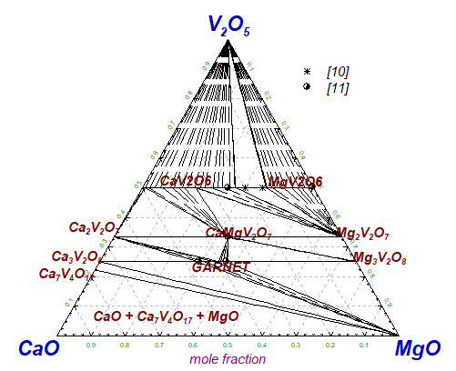
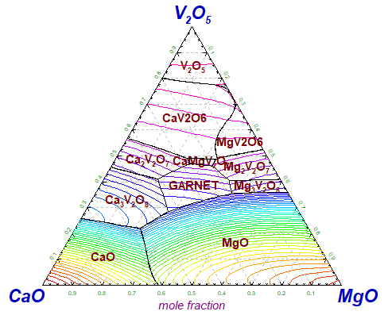
CaO-MgO-V₂O₅

Slide 11
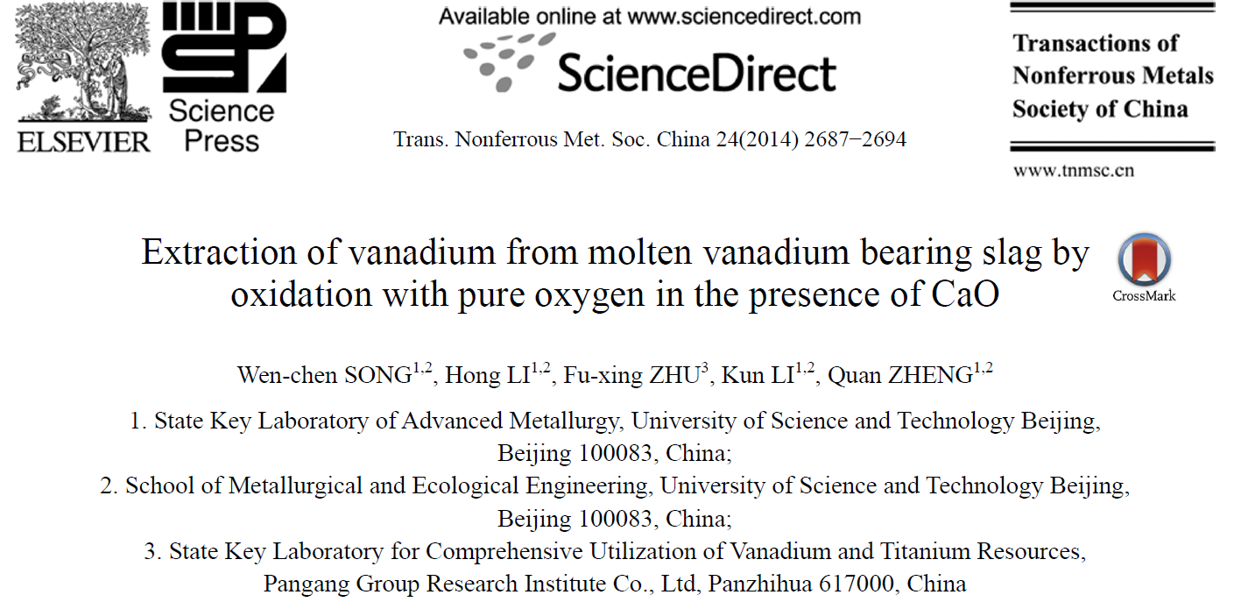
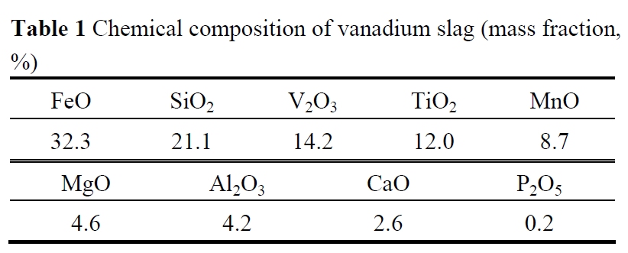
Case study: Vanadium recovery from LD converter slag

Slide 12
Case study: Vanadium recovery from LD converter slag
Slag
+CaO and O₂
Acid leaching
m(CaO)/m(V₂O₅) = 0.15 to 1
Oxygen blown at T = 1450°C.

Slide 13
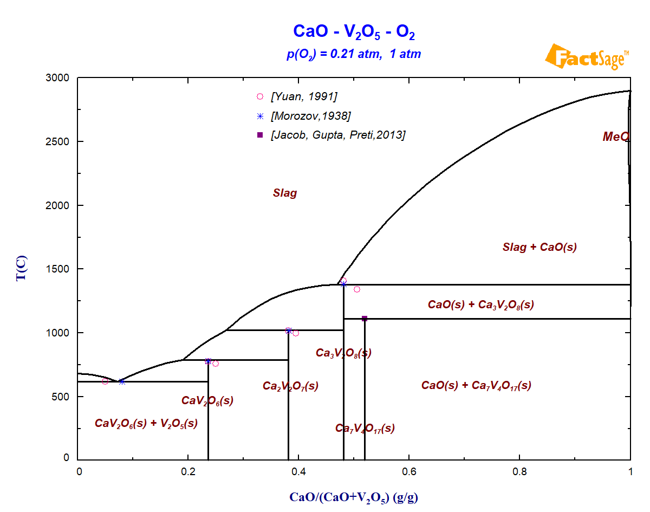
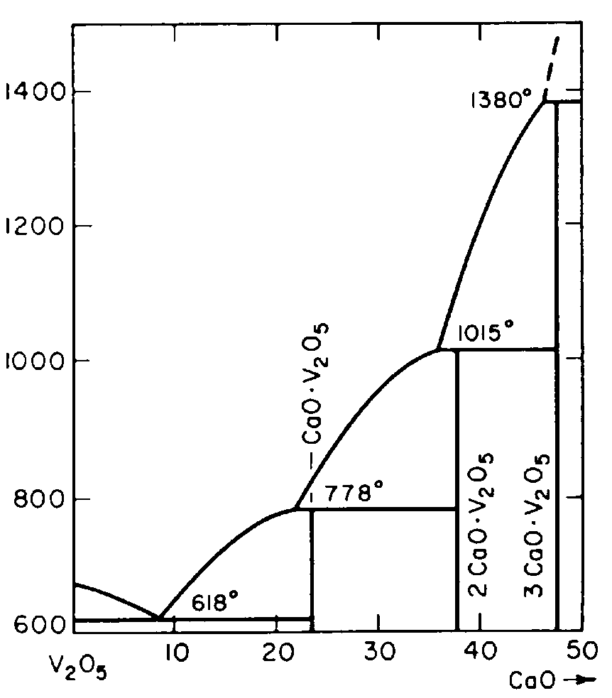
Case study: Vanadium recovery from LD converter slag

Slide 14
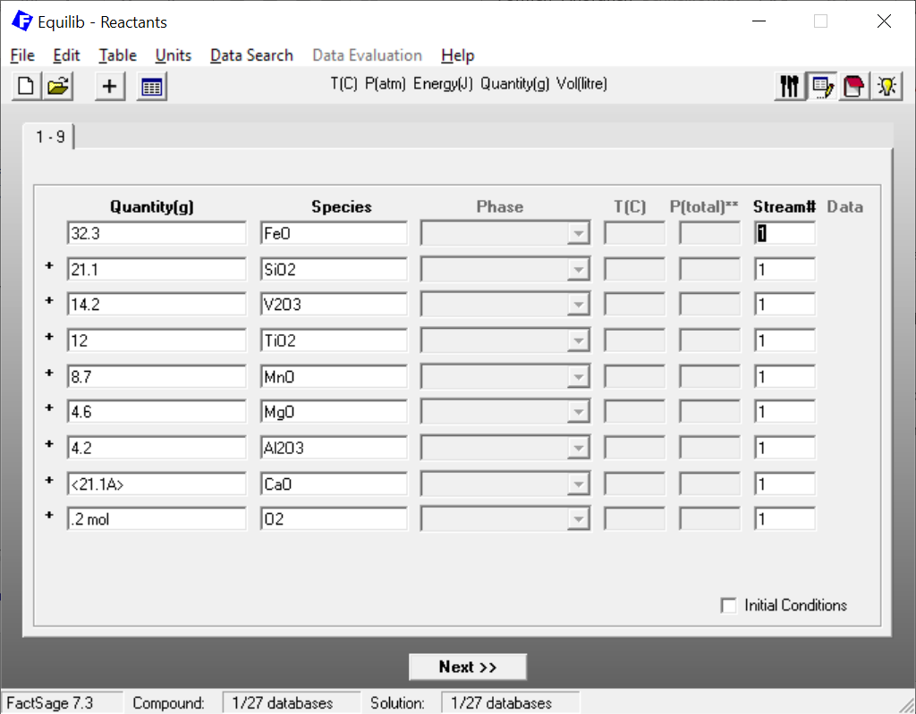
Case study: Vanadium recovery from LD converter slag

Slide 15
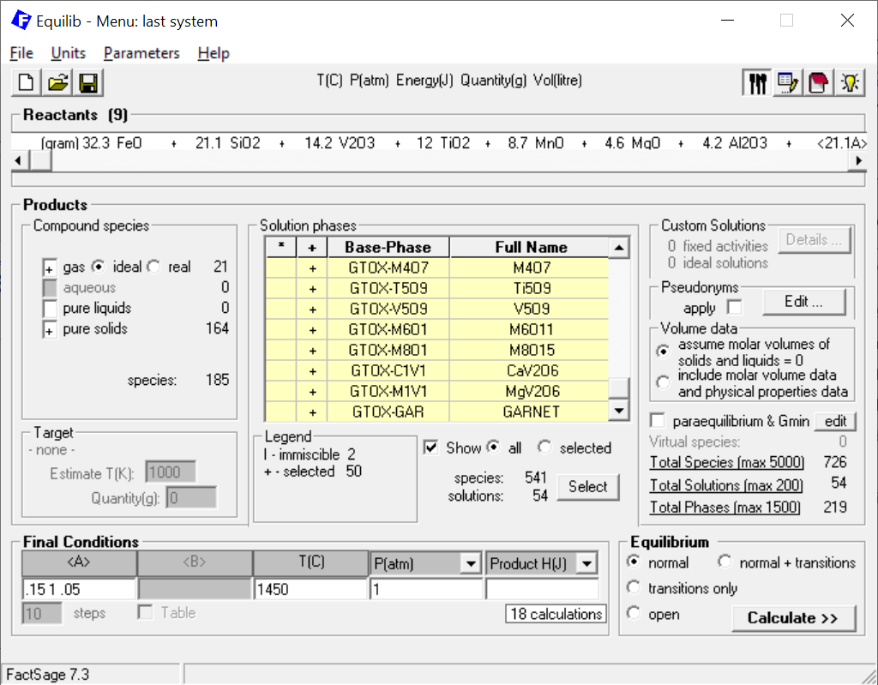
Case study: Vanadium recovery from LD converter slag
m(CaO)/m(V₂O₅) = 0.15 to 1
Oxygen blown at T = 1450°C.

Slide 16
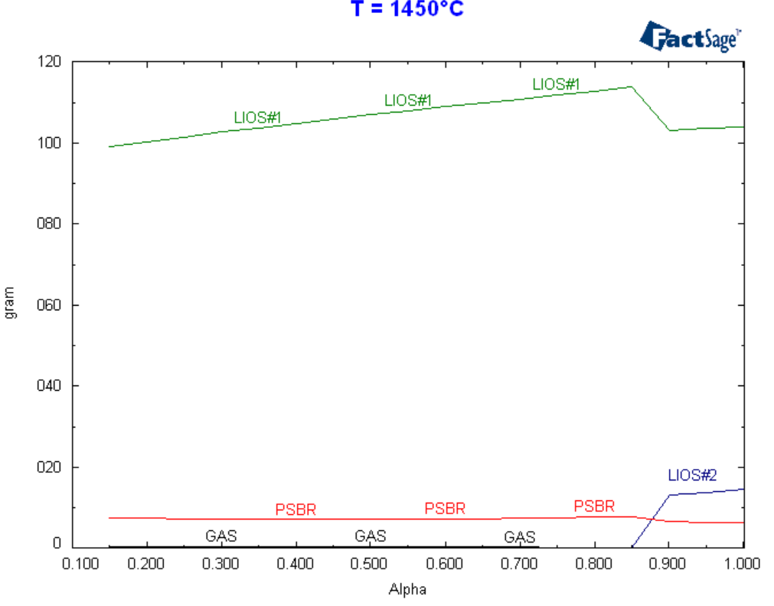
Case study: Vanadium recovery from LD converter slag
LIOS: Liquid Oxide Slag
LIOS#2: V₂O₅+CaO+MgO-rich
PSBR: Pseudobrookite MgAlTiO₅
m(CaO)/m(V₂O₅)

Slide 17
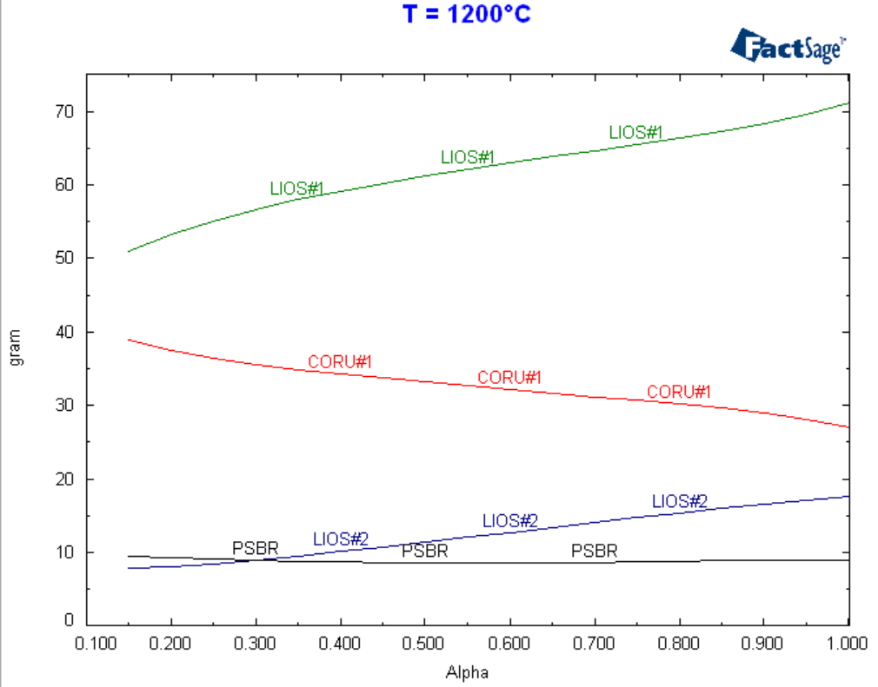
Case study: Vanadium recovery from LD converter slag
LIOS: Liquid Oxide Slag
CORU: Corundum-Fe₂O₃
LIOS#2: V₂O₅+CaO+MgO-rich
PSBR: Pseudobrookite MgAlTiO₅
m(CaO)/m(V₂O₅)

Slide 18
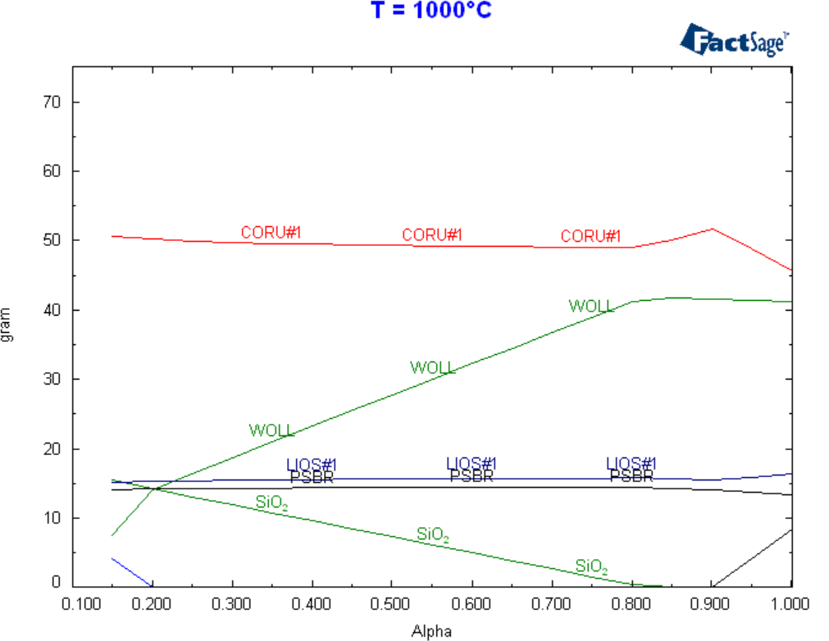
Case study: Vanadium recovery from LD converter slag
CORU: Corundum-Fe₂O₃
WOLL: Wollastonite CaSiO₃
LIOS: V₂O₅+CaO+MgO-rich
PSBR: Pseudobrookite MgAlTiO₅
m(CaO)/m(V₂O₅)

Slide 19
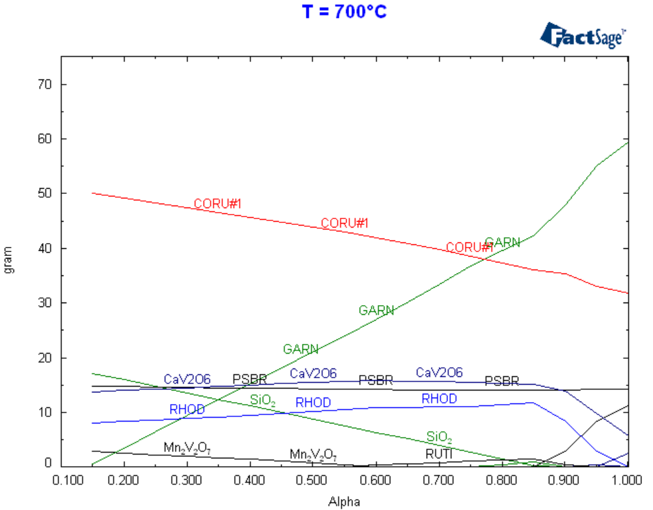
Case study: Vanadium recovery from LD converter slag
GARN: Garnet Fe₂Ca₃Si₃O₁₂
CORU: Corundum-Fe₂O₃
RHOD: Rhodonite (Mn,Ca,Mg)SiO₃
PSBR: Pseudobrookite MgAlTiO₅
m(CaO)/m(V₂O₅)

Slide 20
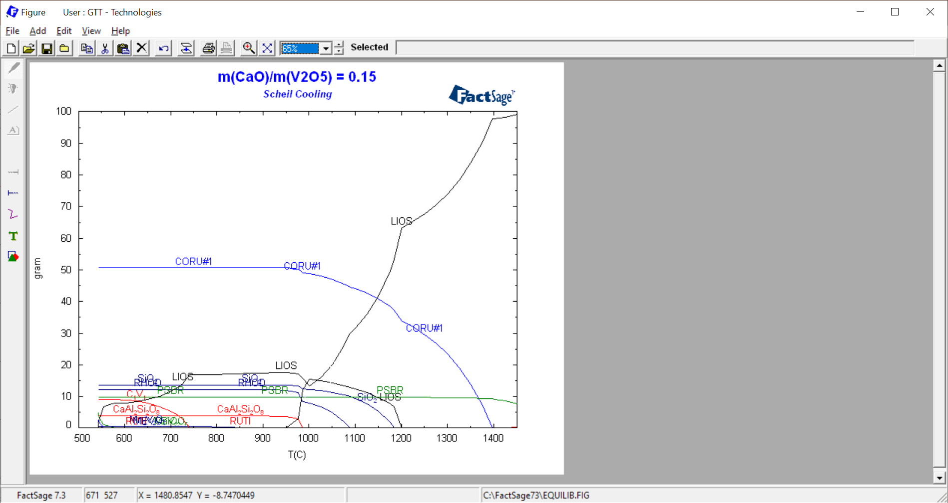
Case study: Vanadium recovery from LD converter slag

Slide 21
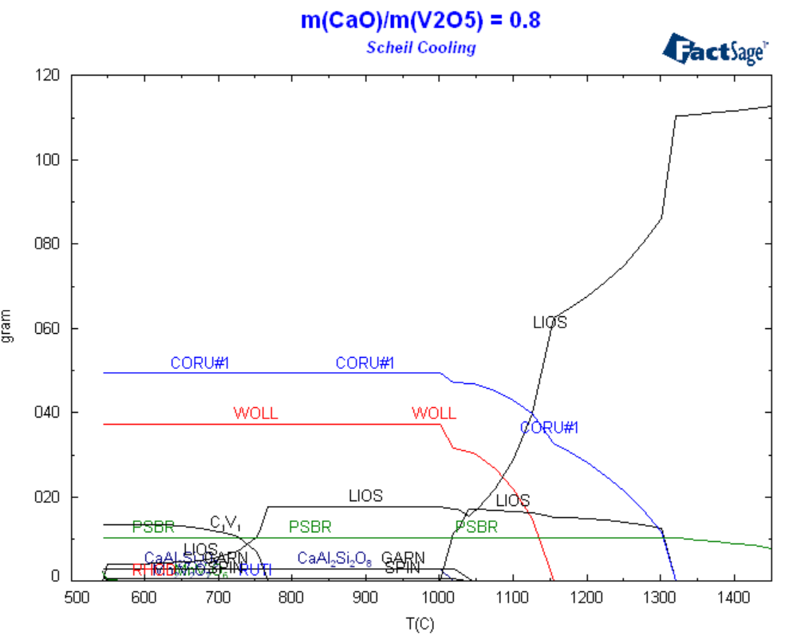
Case study: Vanadium recovery from LD converter slag

Slide 22
Case study: Vanadium recovery from LD converter slag
Higher CaO-content
m(CaV₂O₆) increased by 40%
Earlier de-mixing
Earlier precipitation of CaV₂O₆

Slide 23
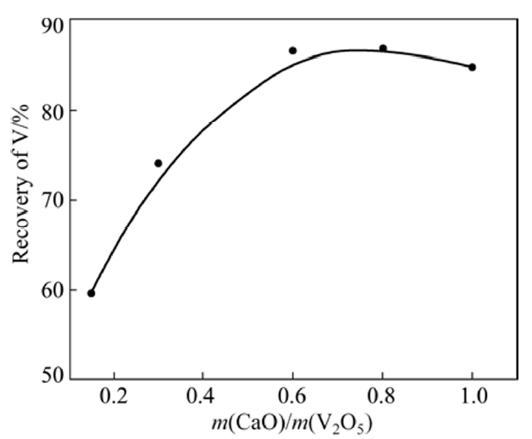
Case study: Vanadium recovery from LD converter slag
Higher CaO-content
m(CaV₂O₆) increased by 40%
Earlier de-mixing
Earlier precipitation of CaV₂O₆
Song et al., Trans. Nonferrous Met. Soc. China 24 (2014) 2687.

Slide 24
Conclusion
Vanadium has been included in GTOx.
Calculations possible for CaO-MgO-Al₂O₃-FeO_{x}-Cr₂O₃-MnO-Mn₂O₃-NiO-SiO₂-TiO₂-Ti₂O₃ system.
Thermochemical calculations enable understanding of processes including multi-component slags.

Slide 25
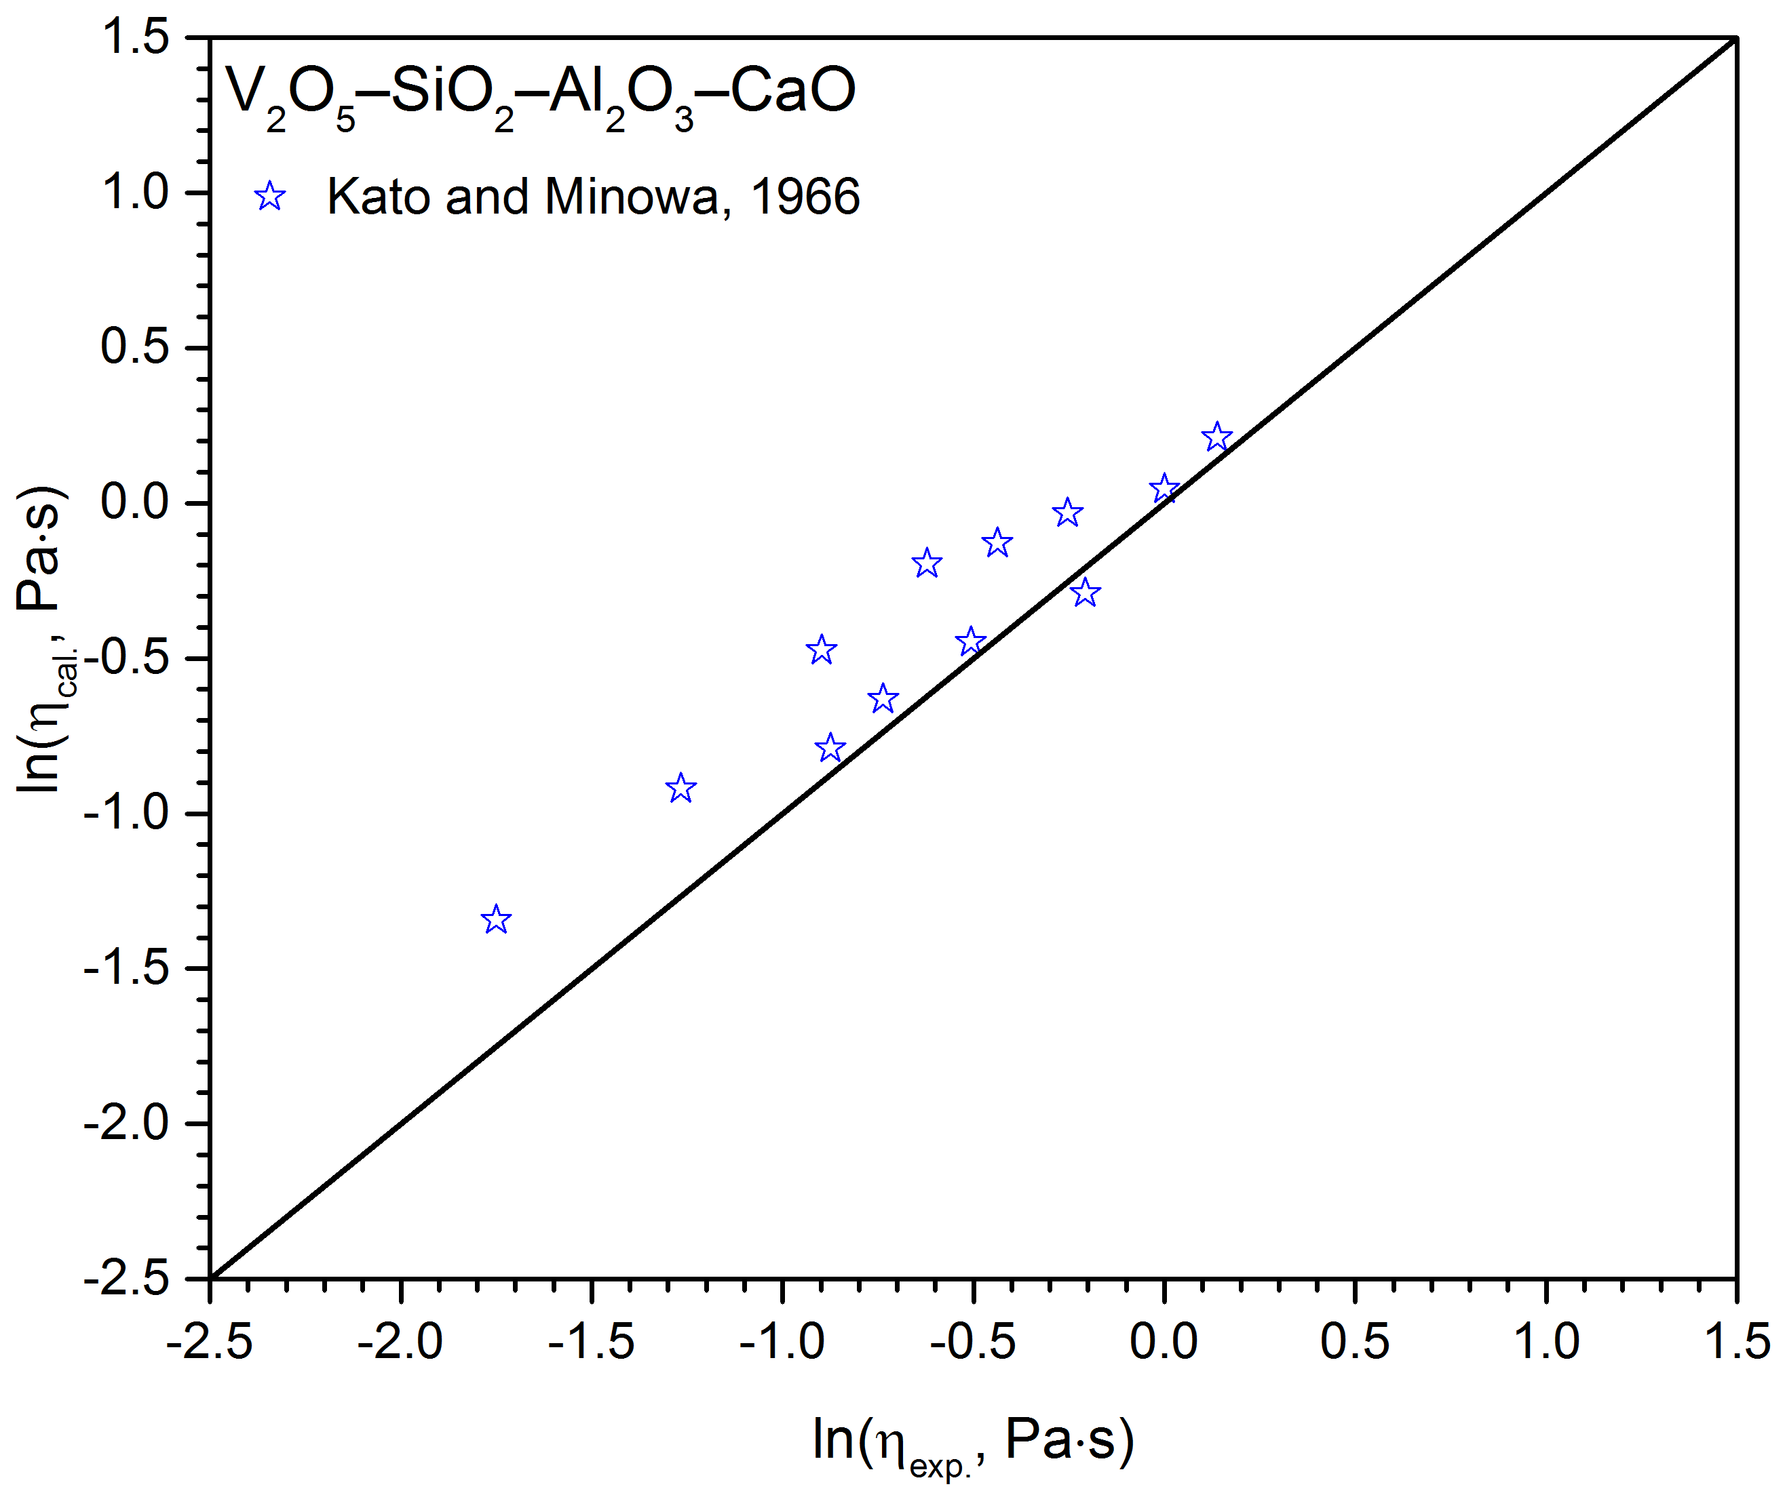
Outlook: Viscosity
Poster Guixuan Wu:
“Inclusion of P₂O₅ and VO_{x} in the viscosity model for molten slag in multicomponent oxide systems”

Slide 26
Thank you very much for your attention!
We acknowledge financial support of the HotVeGas project by the Ministry of Economic Affairs of the Federal Republic of Germany (0327773L) and close collaboration with Research Center Jülich during the development of GTOx.

